Slide 1


The Ad Click Prediction Task: Leveraging Machine Learning
Predicting ad clicks is a crucial task in online advertising. Machine learning algorithms are used to analyze user behavior and predict if a user will click on an ad, optimizing ad delivery and maximizing ROI.
Ashutosh Choudhary – E23CSEU0877
Tushar harsh- E23CSEU2464

Slide 2

Feature Engineering and User Profiling
1
User Demographics
2
Browsing History
Age, gender, location, and interests are valuable features for predicting ad clicks.
Previous website visits, search queries, and purchase history provide insights into user preferences.
3
Device Information
4
Time and Context
The type of device, operating system, and browser used can influence ad click probability.
Time of day, day of week, and current location can impact user engagement with ads.

Slide 3
Modeling Approaches: Logistic Regression, Random Forests, Gradient Boosting
Logistic Regression
Random Forests
Gradient Boosting
A simple and interpretable model that estimates the probability of an ad click.
An ensemble method that combines multiple decision trees to improve accuracy and handle complex relationships.
A powerful technique that sequentially builds weak learners to create a strong predictor.

Slide 4




Deep Learning for Ad Click Prediction
Embedding Layers
Represent features as dense vectors for effective learning by neural networks.
Deep Neural Networks
Learn complex patterns and interactions from high-dimensional data to improve prediction accuracy.
Output Layer
Predicts the probability of an ad click based on the learned representations.

Slide 5
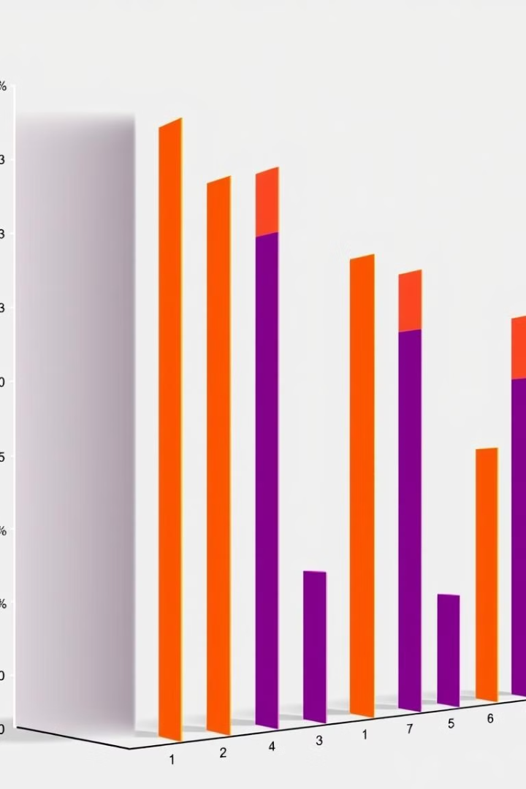
Addressing Data Imbalance: Oversampling, Undersampling, SMOTE
Oversampling
Undersampling
Increases the number of minority class instances by duplicating or creating synthetic samples.
Reduces the number of majority class instances to balance the data distribution.
SMOTE
Generates synthetic minority class samples by interpolating between existing minority class instances.

Slide 6

Protecting User Privacy and Ethical Considerations
Data Anonymization
Protecting sensitive user information by removing identifiable details.
Differential Privacy
Adding noise to data to protect individual records while preserving statistical properties.
Transparency and User Consent
Communicating clearly how user data is collected and used.

Slide 7
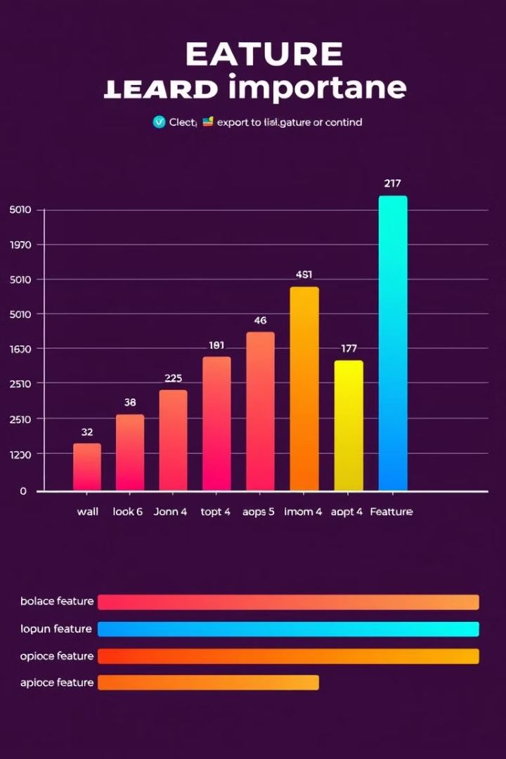
Feature Importance and Interpretability
1
Feature Selection
Identify the most relevant features for predicting ad clicks.
2
Feature Engineering
Transform raw features into more informative representations for the model.
3
Model Interpretation
Understand which features contribute most to the prediction and why.

Slide 8



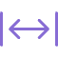
Handling Concept Drift and Adapting to User Behavior Changes
Incremental Learning
Continuously update the model with new data to adapt to changing patterns.
Ensemble Methods
Combine multiple models to improve robustness and handle concept drift.
Monitoring and Evaluation
Track model performance over time and retrain as needed to maintain accuracy.

Slide 9

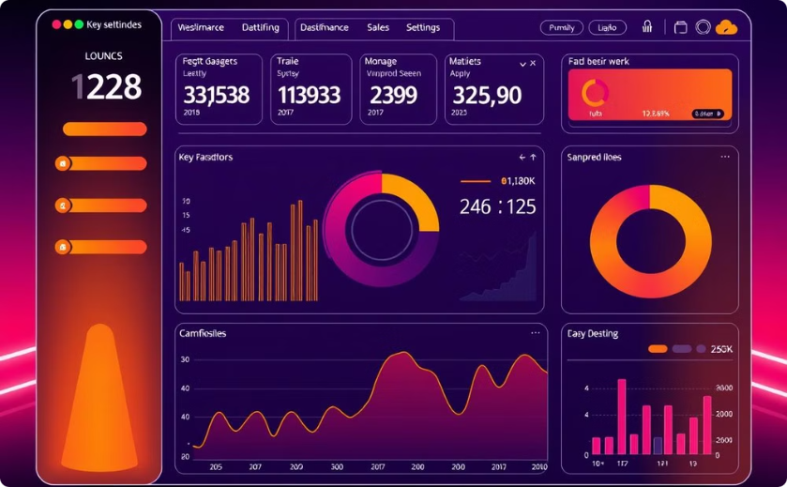
Deploying and Monitoring the Ad Click Prediction System
Cloud Deployment
Performance Monitoring
Leverage cloud infrastructure for scalability and ease of deployment.
Track key metrics like click-through rate, conversion rate, and model accuracy.

